Slide 1

FLIPKART Product Based Company Submitted By Submitted to Vimlesh Kumar Gupta Sarabjit kumar reg. no- 12204918

Slide 2
BRIEF ABOUT FLIPKART
Flipkart is a company providing an e-commerce marketplace offering consumer products including books, media, consumer electronics, lifestyle, and personal and healthcare products.
The company provides services like cash on delivery and 30-day replacement policy. It also offers an in-a-day guarantee and same-day-guarantee, as well as an annual subscription service, Flipkart First.
The company initially focused on online book sales before expanding into other product categories such as consumer electronics, fashion, home essentials, groceries, and lifestyle products.

Slide 3
YEAR OF EXISTENCE WITH HISTORY
History: Flipkart started as an online bookstore in October 2007. The founders Sachin Bansal and Binny Bansal left their jobs at Amazon.com to launch their own company. It was a risky move, since the e-commerce sector in India was mostly non-existentat that time and there was no certainty about its future. However, the founders took the risk and now it has turned out to be a huge success. One of the major problems that Flipkart tackled during its initial years was online payments. At that time, people in India were averse to make online payments to a virtual store. Flipkart solved the problem by launching its ‘Cash on Delivery’ service, which helped build confidence among online buyers. In 2013, the company created a record by selling one lakh books on a single day. In 2016, Flipkart had crossed the 100 million mark in registered customers.

Slide 4
COUNTRY OF ORIGIN & COUNTRIES FOR BUSINESS
Flipkart is an Indian e-commerce company, headquartered in Bangalore, and incorporated in Singapore as a private limited company.
As of now, Flipkart doesn't deliver items internationally. You will be able to make your purchases on our site from anywhere in the world with credit/debit cards issued in India and 21 other countries, but please ensure the delivery address is in India.

Slide 5
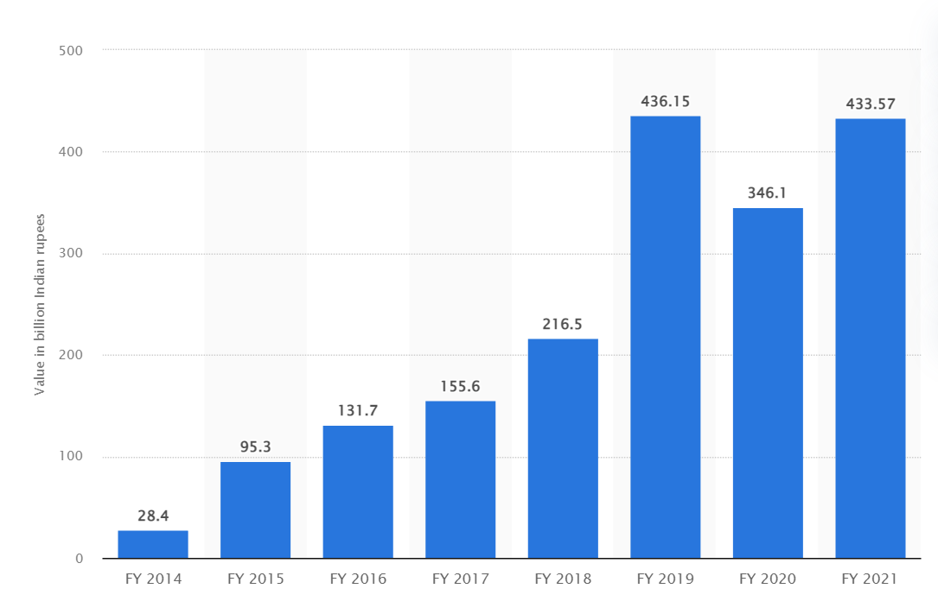
Revenue as per the NSE/ NYSE (Last 5 years)

Slide 6
Total Revenue In 2017 Was That Of Rs 15560 Crore.
Total Revenue In 2018 Was That Of Rs 21650 Crore.
Total Revenue In 2019 Was That Of Rs 43615 Crore.
Total Revenue In 2020 Was That Of Rs 34610 Crore.
Total Revenue In 2021 Was That Of Rs 43357 Crore.

Slide 7
Leadership Hierarchy of the Company
Sachin Bansal, Co-founder and Executive Chairman.
Binny Bansal, Co–founder of Flipkart
Kalyan Krishnamurthy serves as the CEO / President of Flipkart.
Anand Lakshminarayanan serves as the Vice President of Flipkart.
Mayur Datar serves as the Chief Data Scientist, VP of Engineering of Flipkart.
Krishnendu Chaudhury serves as the Principal Scientist and Head of Image Sciences of Flipkart.

Slide 8
References of LPU Alumni working Company
Shyam Koyyaneni (linkedin.com/in/shyam-koyyaneni-277063143)
Ayush Saxena (linkedin.com/in/ayushsaxena129)
Jatin Chutani (linkedin.com/in/jatin-chutani)
Altamash Sheikh (linkedin.com/in/altamash-sheikh-232842139)

Slide 9
Employee Base of flipkart
Name Position Location
Ajit Singh Senior Manager II Dubai
Mayur Datar Senior Vice President California, USA
Aakriti Agarwal Director Bangalore, Karnataka
Aneesh Adasan Senior Tax Manager Mumbai Metropolitan
Anusua Trivedi Director Applied Science Washington, USA
Kannan Ganesan Vice President Bangalore Urban,Karnataka
Aditya Limaye Manager ‑ Business Development Bengaluru, Karnataka

Slide 10
Rankings of the Flipkart(Walmart) (Forbes Fortune 500 etc.)
Forbes (Walmart) 23rd rank (Global)
Fortune (Walmart) 1st rank (Global)
Linkedin 22nd rank (india)
Greatplacetowork 11th rank (India)
Similarweb 94th rank (global)

Slide 11
Technologies used in the Company
Flipkart uses 47 technology products and services. Flipkart is actively using 111 technologies for its website, according to BuiltWith. These include Viewport Meta, IPhone / Mobile Compatible, and Google Font API.
HTML5
Google Analytics
javascript
jQuery,
Microsoft Azure
Hazelcast
artificial intelligence (AI)
machine learning (ML )
internet of things (IoT)
robotics

Slide 12
Major Products of the Flipkart with Clients
The Company provides books, movies, music, games, consoles, televisions, mobiles, digital cameras, computers, network components, software, peripherals, apparel, shoes, and kitchen appliances.
MarQ
Perfect Homes
Billion
Walmart
Smart-Buy

Slide 13
Major Services by the Flipkart with Clients
Flipkart Online Services Private Limited owns and operates e-commerce website. The Company provides books, movies, music, games, consoles, televisions, mobiles, digital cameras, computers, network components, software, peripherals, apparel, shoes, and kitchen appliances.
Flipkart EMI Payment Option,
On-Time Delivery Sevices (Ekart)
Return & Exchange Policies
Online Health Services (Flipkart Health+)
After Sales Services
Online payment Services (PhonePe)
Global online Travel Services (Cleartrip)

Slide 14
Operational Verticals Of The FLIPKART With Clients
Social Commerce
Venture Shopsy
Recommerce Business
Travel Platform Cleartrip
Logistics
Customer Supports
Warehouse
Procedurements

Slide 15
Roles you are interested with flipkart
Engineering Manager.
Software Development Engineer.
Architect.
UI Engineer.
Assistant Manager.
Site Reliability Engineer.
IT Analyst.

Slide 16
Packages offered by Flipkart for roles
Engineering Manager. : 69.4 Lakh/year
Architect. : 82 lakh/year
Software Development Engineer I. : 23.5 Lakh/year
UI Engineer. : 23.8 Lakh/year
Assistant Manager. : 10.5 lakh/year
Site Reliability Engineer. : 11 Lakh/year
IT Analyst : 8 Lakh/year

Slide 17
Visits Flipkart Gave To LPU Campus

Slide 18
Pros & Cons of the Flipkart
Pros Cons
Flipkart is really India’s largest online They deliver products only in India. No service
mega store. They have huge number of available outside India even if you are willing
products in multiple categories. to pay extra money.
Flipkart has tie ups with multiple One of the major complaints I have been hearing recently
courier services and hence can deliver is their service. Sometimes, the products are delivered but
most of the products to most of the areas the packages are empty making the customers stunned
in time.
Flipkart offers good discounts on many The service is not upto the mark in villages when compared
available of the products which you hardly to the urban areas.
find on other websites.
Flipkart sells only good quality, branded and The minimum order for free home delivery is increased
non-damaged products only. to 500/- recently while some other sites are doing it
for lesser than that

Slide 19
List of the references weblinks, articles etc.
https://en.wikipedia.org/wiki/Flipkart
https://www.linkedin.com/company/flipkart/?originalSubdomain=in
https://www.youtube.com/results?search_query=flipkart+company
https://www.ambitionbox.com/salaries/flipkart-salaries/engineering-manager

Slide 20
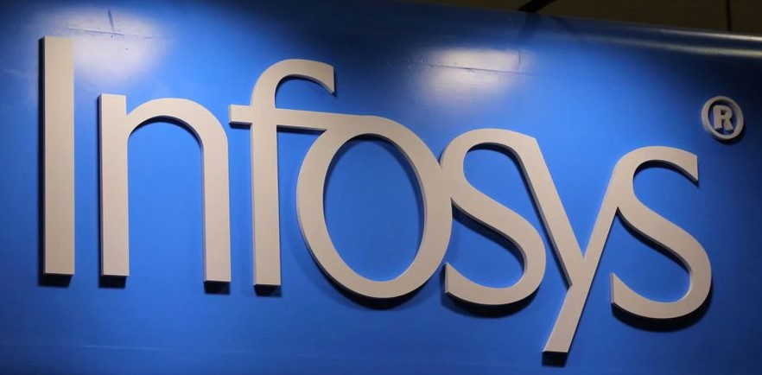
INFOSYS
SERVICE BASED COMPANY
SUBMITTED BY SUBMITTED TO
Vimlesh kumar Gupta Sarabjit Kumar
REG NO.- 12204918

Slide 21
BRIEF ABOUT FLIPKART
Infosys Limited is an Indian multinational information technology company that provides business consulting, information technology and outsourcing services.
The company was founded in Pune and is headquartered in Bangalore.
Infosys is the second-largest Indian IT company, after Tata Consultancy Services, by 2020 revenue figures, and the 602nd largest public company in the world, according to the Forbes Global 2000 ranking.

Slide 22
YEAR OF EXISTENCE WITH HISTORY
Infosys was founded by seven engineers in Pune, Maharashtra, India. Its initial capital was $250.
It was registered as Infosys Consultants Private Limited on 2 July 1981. In 1983, it relocated to Bangalore, Karnataka.
The company changed its name to Infosys Technologies Private Limited in April 1992 and to Infosys Technologies Limited when it became a public limited company in June 1992. It was renamed Infosys Limited in June 2011.
In 2012, Infosys announced a new office in Milwaukee, Wisconsin, to serve Harley-Davidson. Infosys hired 1,200 United States employees in 2011 and expanded the workforce by 2,000 employees in 2012.

Slide 23
COUNTRY OF ORIGIN & COUNTRIES FOR BUSINESS
Infosys is an Indian multinational information technology company that provides business consulting, information technology and outsourcing services. The company was founded in Pune and is headquartered in Bangalore.
Infosys is a global leader in next-generation digital services and consulting. they enable clients in more than 50 countries to navigate their digital transformation.
Infosys has 82 sales and marketing offices and 123 development centres across the world as of 31 March 2018, with major presence in India, United States, China, Australia, Japan, Middle East and Europe.

Slide 24
REVENUE AS PER THE NSE/ NYSE (LAST 5 YEARS)
16.3 billion U.S. dollars 2022
13.56 billion U.S dollars 2021
12.78 billion U.S dollars 2020
11.79 billion U.S dollars 2019
10.93 billion U.S dollars 2018

Slide 25
LEADERSHIP HIERARCHY OF THE INFOSYS
NAME POSITION
Salil Parekh Chief Executive Officer and Managing Director
Nandan M. Nilekani Co-founder and Chairman of the Board
Kiran Mazumdar-Shaw Lead Independent Director, Infosys
inderpreet Sawhney Chief Compliance Officer
Jayesh Sanghrajka Deputy Chief Financial Officer
Kapil Jain Global Head
Kiran Mazumdar Shaw Lead Independent Director

Slide 26
REFERENCES OF LPU ALUMNI WORKING INFOSYS
Tanvi Jain (linkedin.com/in/tanvi-jain-b3080b1b1)
Rajni Singh (linkedin.com/in/rajni-singh-240142171)
Bhupendra kumar (linkedin.com/in/bhupendra-kumar-71807a15a)
Imran Sadiq (linkedin.com/in/imran-sadiq-49b68a127)
Neelam Shukla (linkedin.com/in/neelam-shukla)
Tejokanth Karinki (linkedin.com/in/tejokanth7872)
Swetank Singh (linkedin.com/in/swetank-singh-b38101151)

Slide 27
Employee Base (Country wise)
NAME POSITION LOCATION
Erick Federico Partida Technology Lead Arizona, USA
Hurtado
Ella Rozenblum Technology Analyst Massachusetts, USA
Subhadip Das Technology Lead India
Mark Weiss Product Owner/Scrum Master Colorado, USA

Slide 28
Rankings of the INFOSYS (Forbes Fortune 500 etc.)
Forbes 540th Rank (Global)
Brand Finance 2022 3rd Rank (india)
It Services 25 3rd Rank (india)
Linkedin 4th rank (india)

Slide 29
Technologies used in the INFOSYS
Infosys uses 103 technology products and services, according to G2 Stack. Infosys is actively using 82 technologies for its website, according to BuiltWith. Some highly used technologies are-
HTML5
Google Analytics
jQuery
AI/ML
Conversational AI
IoT
blockchain
Computer Vision
AR-VR
Deep Learning

Slide 30
Major Products of the company with Clients
NIA – Next Generation Integrated AI Platform
Infosys Information Platform (IIP), an analytics platform
EdgeVerve Systems, which includes Finacle, a global banking platform
Panaya Cloud Suite
Skava (now Infosys Equinox)

Slide 31
Major Services By The INFOSYS With Clients
Experience. Digital Marketing. Digital Experience. Infosys Metaverse Foundry.
Infosys Consulting – a global management consulting service
Cloud-based enterprise transformation services
Engineering Services
Digital Marketing
Applied AI.
Innovate, Blockchain.
Enterprise Agile DevOps.
Microsoft Business Application Services.
Energy Transition.
Assure, Cyber Security.

Slide 32
Operational Verticals Of The INFOSYS With Clients
Personalized digital experiences.
Predictive enterprise business processes.
AI-driven intelligent automation.
Agile, resilient enterprise with nimble processes, IT and people.
Hybrid cloud with interoperable public and private cloud applications, platforms and infrastructure.

Slide 33
Roles You Are Interested With INFOSYS
Senior Project Manager, IT
Information Technology (IT) Consultant
Information Technology (IT) Lead
Software Test Lead
Team Leader, IT
SAP Consultant
Senior Software Engineer
Technology Analyst

Slide 34
Packages Offered By INFOSYS For Roles
Senior Project Manager, IT : 19 Lakh/year
Information Technology (IT) Consultant : 10.72 Lakh/year
Information Technology (IT) Lead : 9.63 Lakh/year
Software Test Lead : 9.78 Lakh/year
Team Leader, IT : 9.89 Lakh/year
SAP Consultant : 8.73 Lakh/year
Senior Software Engineer : 6.44 Lakh/year
Technology Analyst : 6.30 Lakh/year

Slide 35
Visits INFOSYS Gave To LPU Campus

Slide 36
Pros & Cons Of The INFOSYS
PROS CONS
Infosys as a company is one of the most : Infosys has had an non-linear growth in
respected company in India. terms of resources.
Working with Infosys has created a brand : In my opinion, infosys is struggling majorly
value for me. with people management.
Also it has helped me gain international : The freedom for people to work in their exposure in terms of experience and handling area of intrest is very limited.
of professional clients.
It has helped me develop the insight to various : The middle managers are completely
challenges which the IT industry of Developed world theoritical and process oriented
country face today.
It has expanded my horizons of thinking and instilled : It feels like a employee is completely an approach within me to handle micro as well as macro detached from its management
level problems and issues.

Slide 37
List Of The References Weblinks, Articles Etc.
https://en.wikipedia.org/wiki/Infosys
https://www.youtube.com/results?search_query=infosys
https://www.linkedin.com/company/infosys/?originalSubdomain=in
https://www.forbes.com/companies/infosys/?sh=25151aaf4f81

